Slide 1
Lab Meeting
18 July 2023
Jochum, Michael D., Stuyck, Olivia M.

Slide 2
Update
JMAC Update
Metaphlan4 complete (1267/1267 (100%)
Humann3 (168/1267) (~13%)
BaBs Processing update
L. plantarum bowtie2 vs Maternal Samples
Vaginal introitus (706/706)(100%)
Maternal Stool (65/583) (11%)
Neonate microbiome abundance tables (Incomplete)
Fistula study Figure update (~ 90%)
FeSST manuscript (Figures and annotations complete) (100%)
SMITH Update (75%)
Redownload complete
TODO:
Run bowtie2 mapping against human Grch38
agglomerate the bowtie2 outputs to confirm the poor read coverage was a product of run failure instead of an incomplete download.

Slide 3
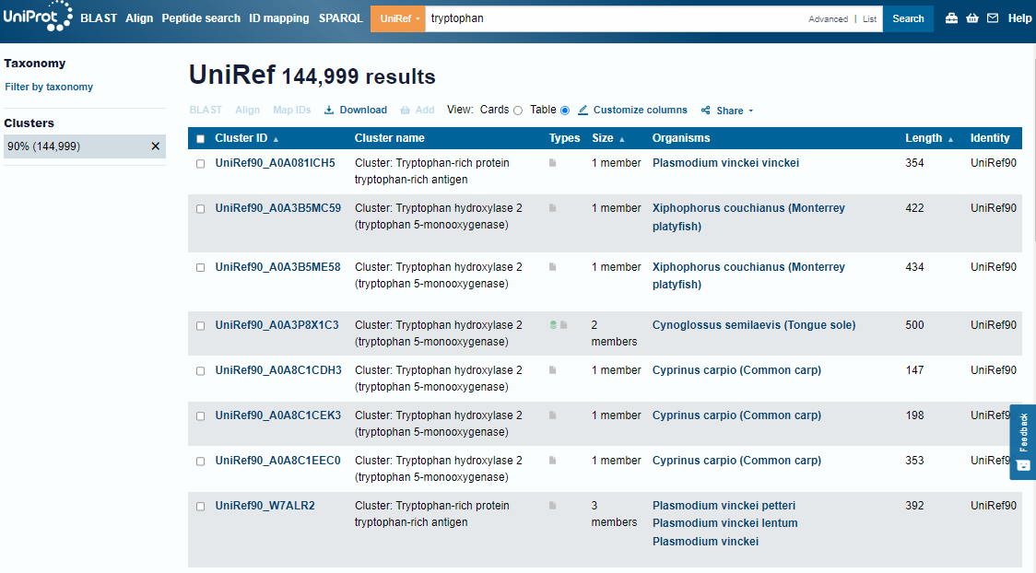
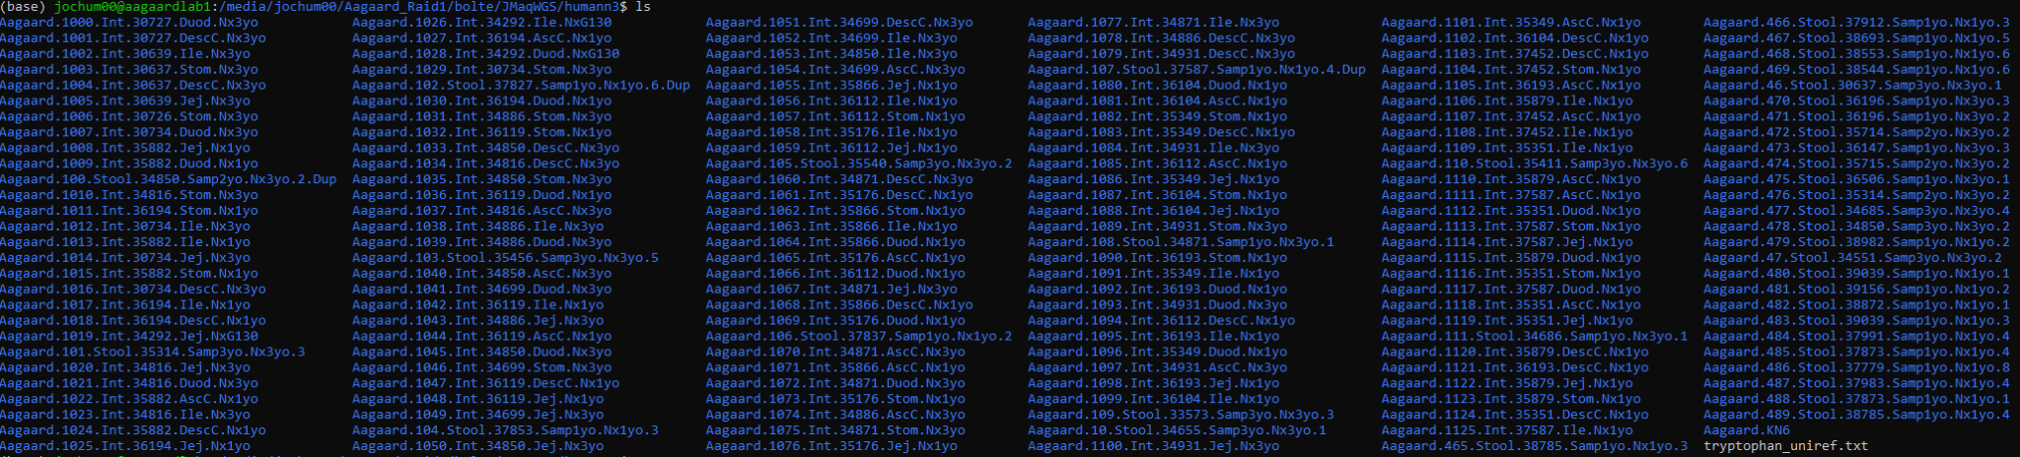
JMAC Update
Humann3
168/1267 samples completed (~13%)
144k Uniref90 tryptophan biosynthesis proteins
Why?
Humann3 != Metaphlan4
Notes:
Originally the versions were not compatible with one another. Metaphlan 4 had already been run, but had to be rerun on Metaphlan 3 in order to work with Humann3. Behind on running the samples because of this issue.

Slide 4
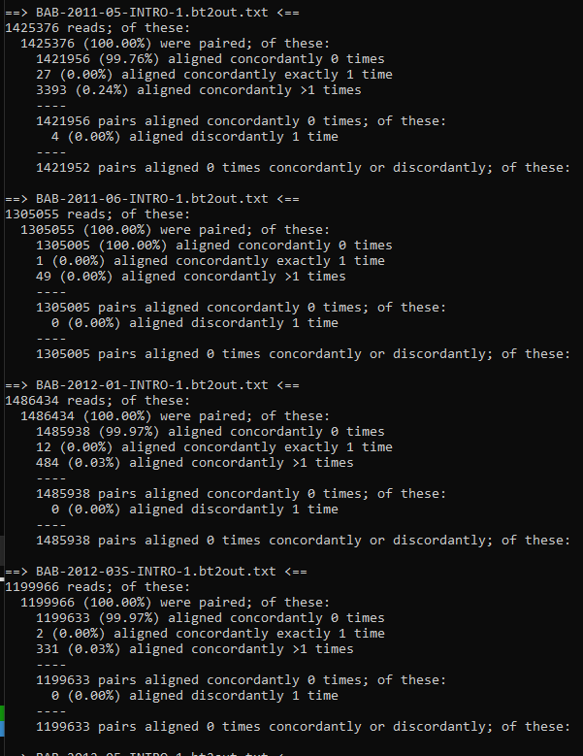
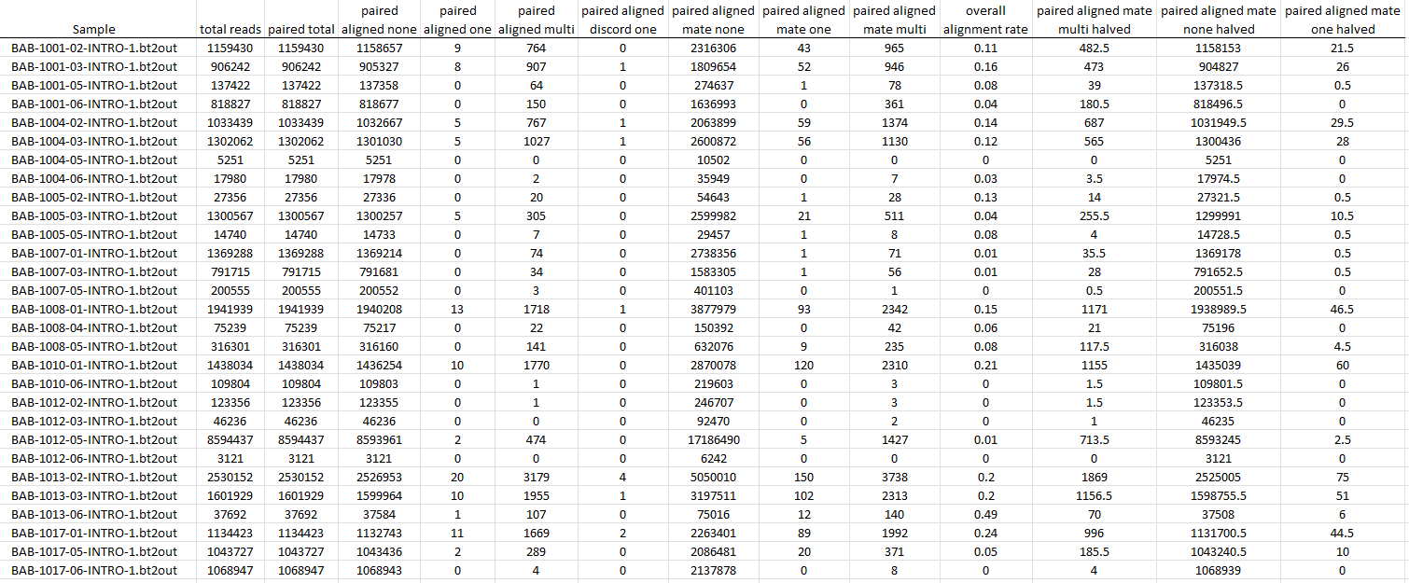
BaBs Processing update
L. plantarum bowtie2 vs Maternal Samples
Neonate abundance Tables
Notes:
Bowtie2 has been completed on the L. plantarum in vaginal introitus. Found 0.9% alignment of L. plantarum in vaginal introitus. Maternal stool is being worked on.

Slide 5
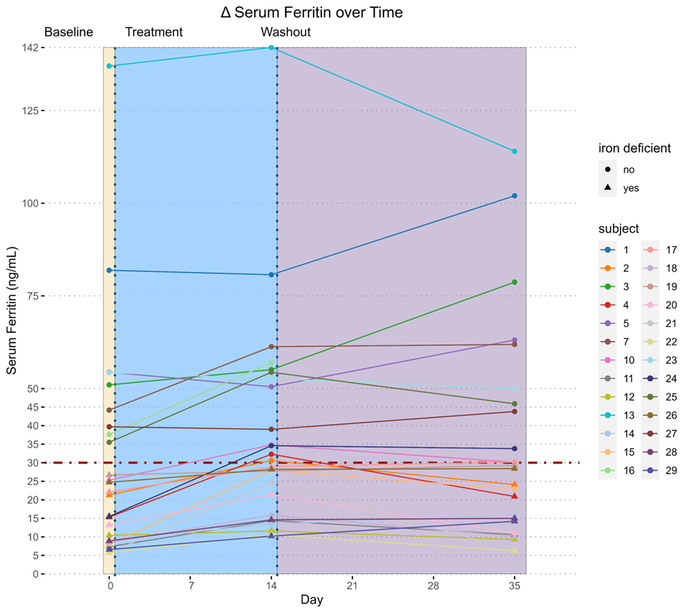
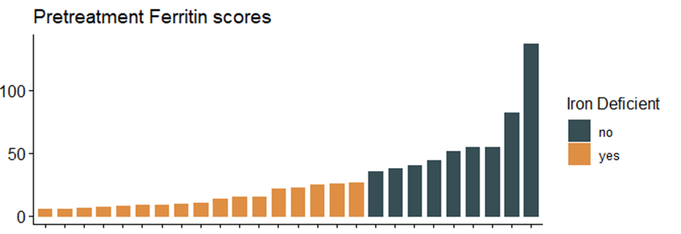
FeSST manuscript Figures
B)
A)
Figure 1. A) Change in Δ serum ferritin over time. Day 0 = baseline; day 2-14 = treatment; day 15-35 = washout. Treatment periods are depicted as the vertical dashed blue lines. Iron deficiency cutoff is depicted as the horizontal dashed red line. Subjects are the colored lines. B) Barchart showing range of ferritin scores at baseline (all subjects) and posttreatment for subjects who were iron deficient at baseline. Bars are colored by iron deficiency threshold cutoff at 30 ng/ml and sorted by serum Ferritin level.
Notes:
Figures and annotations have been added to the manuscript.
An overview of the change in Ferritin over time
Definitions of iron deficient at baseline (Day 0 <30)
And response to iron therapy (day 14 <30)
1.What are the differences in those that were iron deficient compared to normal at baseline?
2.Amongst those that were iron deficient at baseline, what was the difference between those that responded compared to those that did not respond?

Slide 6
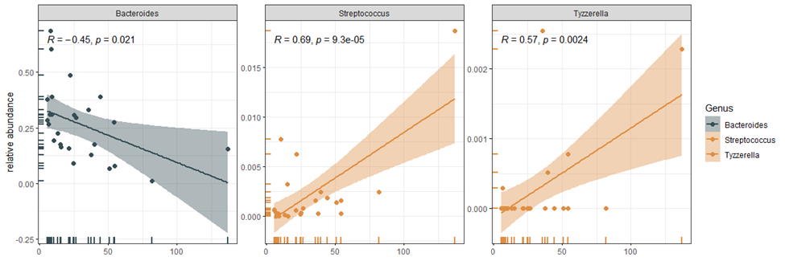
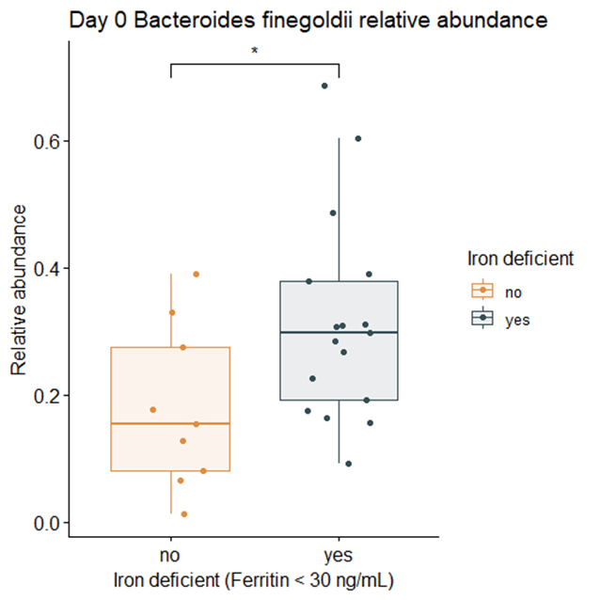
FeSST manuscript Figures
A)
B)
Day 0 Ferritin (ng/ml) score
Day 0 Ferritin (ng/ml) score
Day 0 Ferritin (ng/ml) score
Figure 2. A) Relative abundance over time (days) scatterplots for keystone taxa associated with baseline iron deficiency where the x axis represents serum ferritin levels at baseline, the y axis represents the relative abundance for each keystone and the color represents the associated with iron deficiency at baseline. B) Taxonomic boxplot comparison of the relative abundance of Bacteroides finegoldii across iron deficiency at baseline.
Notes:
This figure shows the distribution of ferritin scores at baseline, separated by bug. The more iron deficient one was, the greater counts of bacteroides present. Subjects with higher ferritin scores had greater counts of Streptococcus and Tyzzerella
Going into more detail about the bacteroides graph in figure A. At baseline, the iron deficient subjects had greater counts of bacteroides.

Slide 7
FeSST manuscript Figures
feature | coef | stderr | pval | name | qval | N | N.not.zero
Bacteroides_ASV_4 | -0.624 | 0.206 | 0.006 | day_0 | 0.137 | 26 | 26
Tyzzerella_ASV_638 | 0.688 | 0.201 | 0.002 | day_0 | 0.054 | 26 | 5
Streptococcus_ASV_25 | 1.362 | 0.395 | 0.002 | day_0 | 0.054 | 26 | 22
Table 1. Maaslin2 identified keystone taxa associated with iron deficiency at baseline.
Notes:
Maaslin2 was used in the table to determine these 3 bugs are significant contributors to the study.

Slide 8
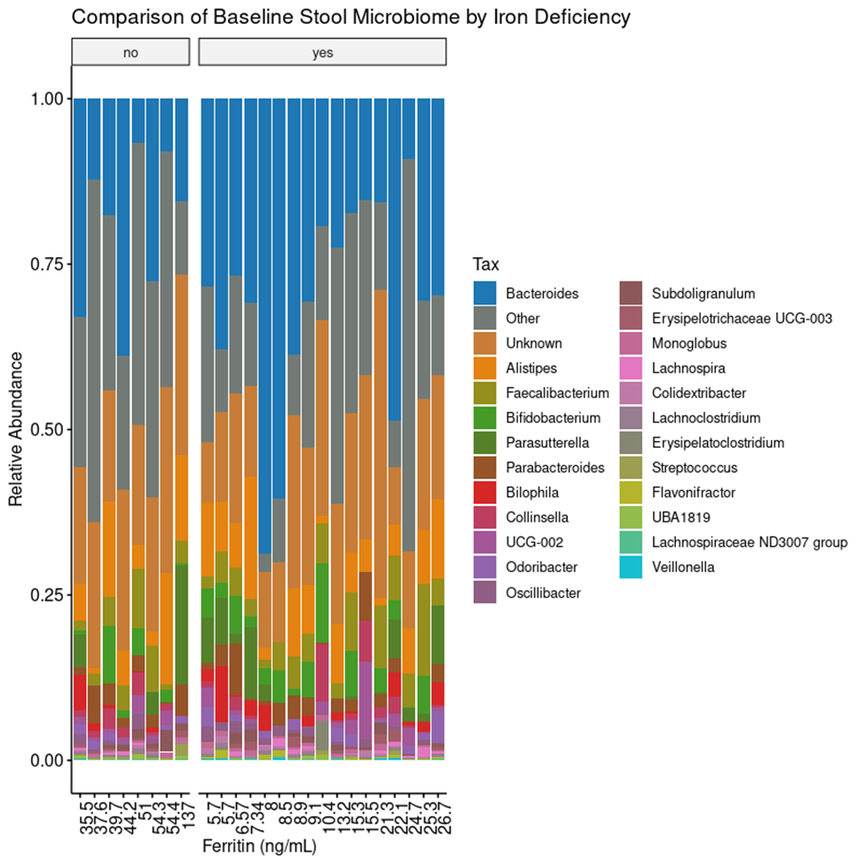
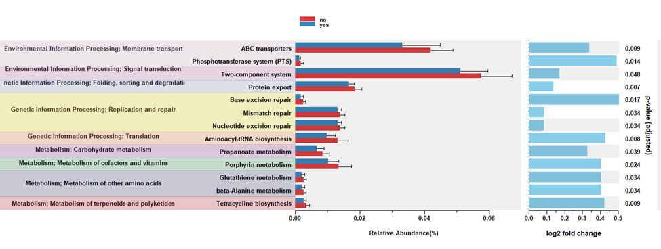
FeSST manuscript Figures
A)
B)
Figure 3. A) Taxonomic Comparisons of iron deficiency at baseline. Stacked bar chart overview of genus level microbiome community composition grouped by iron deficiency status and sorted by Serum ferritin (ng/ml) at baseline. B) Inferred functional microbiome comparisons of iron deficiency at baseline. Panel represents the KEGG / KO pathways comparisons as a horizontal bar chart for significantly differentially expressed genes from the microbiome community composition compared by iron deficiency status at baseline.
Notes:
Another graph comparing the differences in the relative abundances of bugs between those iron deficient at baseline and those not. Shows again that bacteroides are more present in those who are iron deficient.
Illustrates the inferred functional microbiome comparisons of iron deficiency at baseline, along with their relative abundances. Most significant differences were seen in protein export, Aminoacyl-tRNA biosynthesis, ABC transporters, tetracycline biosynthesis, and phosphotransferase system.
Protein export - The protein export is the active transport of proteins from the cytoplasm to the exterior of the cell, or to the periplasmic compartment in Gram-negative bacteria. The sec dependent pathway is the general protein export system that transports newly synthesized proteins into or across the cell membrane. The translocation channel is formed from a conserved trimeric membrane protein complex, called the Sec61/SecY complex. The twin-arginine translocation (Tat) pathway is another protein transport system that transports folded proteins in bacteria, archaea, and chloroplasts. Many Tat systems comprise three functionally different membrane proteins, TatA, TatB, and TatC, but TatA and TatE seem to have overlapping functions, with TatA having by far the more important role.
Aminoacyl-tRNA biosynthesis
ABC transporters - The ATP-binding cassette (ABC) transporters form one of the largest known protein families, and are widespread in bacteria, archaea, and eukaryotes. They couple ATP hydrolysis to active transport of a wide variety of substrates such as ions, sugars, lipids, sterols, peptides, proteins, and drugs. The structure of a prokaryotic ABC transporter usually consists of three components; typically two integral membrane proteins each having six transmembrane segments, two peripheral proteins that bind and hydrolyze ATP, and a periplasmic (or lipoprotein) substrate-binding protein. Many of the genes for the three components form operons as in fact observed in many bacterial and archaeal genomes. On the other hand, in a typical eukaryotic ABC transporter, the membrane spanning protein and the ATP-binding protein are fused, forming a multi-domain protein with the membrane-spanning domain (MSD) and the nucleotide-binding domain (NBD).
Tetracycline biosynthesis - Tetracyclines are aromatic polyketide antibiotics produced by Streptomyces species via type II polyketide synthases (PKSs). Tetracyclines contain a linear tetracyclic skeleton, which is formed from a malonamate starter unit and malonyl-CoA extender units through a common polyketide pathway [MD:M00778]. This diagram shows biosynthesis of naturally occurring tetracyclines (tetracycline, oxytetracycline and chlortetracycline) via a common intermediate anhydrotetracycline [MD:M00780 M00823].
Phosphotransferase system (PTS) - The phosphoenolpyruvate (PEP)-dependent phosphotransferase system (PTS) is a major mechanism used by bacteria for uptake of carbohydrates, particularly hexoses, hexitols, and disaccharides, where the source of energy is from PEP. The PTS consists of two general components, enzyme I (EI) and histidine phosphocarrier protein (HPr), and of membrane-bound sugar specific permeases (enzymes II). Each enzyme II (EII) complex consists of one or two hydrophobic integral membrane domains (domains C and D) and two hydrophilic domains (domains A and B). EII complexes may exist as distinct proteins or as a single multidomain protein. The PTS catalyzes the uptake of carbohydrates and their conversion into their respective phosphoesters during transport. There are four successive phosphoryl transfers in the PTS. Initial autophosphorylation of EI, using PEP as a substrate, is followed by transfer of the phosphoryl group from EI to HPr. EIIA catalyzes the self-phosphoryl transfer from HPr after which the phosphoryl group is transferred to histidine or cysteine residues of EIIB. The sugar is transported through the membrane-bound EIIC and is phosphorylated by the appropriate sugar-specific EIIB.

Slide 9
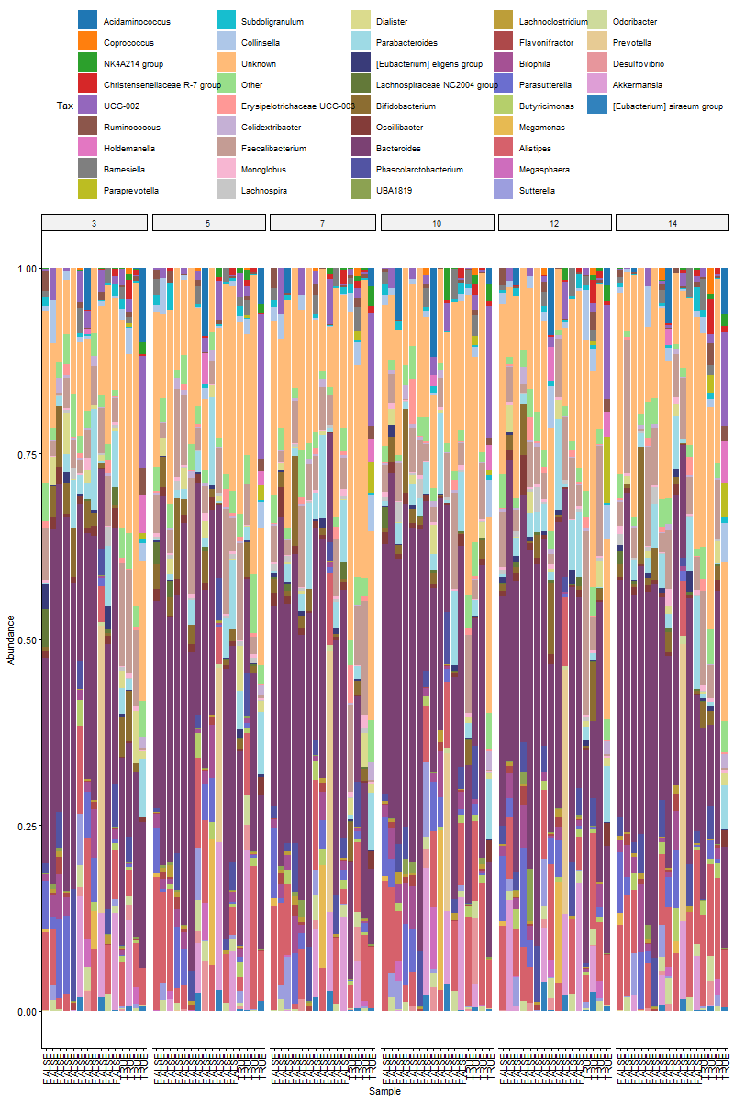
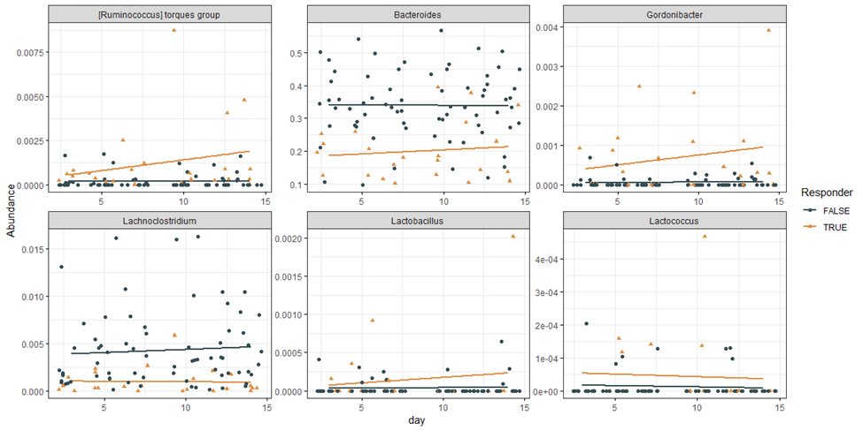
FeSST manuscript Figures
A)
B)
Figure 4. A) Taxonomic Comparisons of iron deficiency at treatment. Stacked bar chart overview of genus level microbiome community composition grouped by iron deficiency status and sorted by Serum ferritin (ng/ml) at baseline. B) Relative abundance over time (days) scatterplots for keystone taxa associated with baseline iron deficiency or response to iron therapy post treatment where the x axis represents time in days, the y axis represents the relative abundance for each keystone and the color represents either the iron deficiency at baseline (top) or the response to iron therapy (bottom) for subjects that were originally iron deficient.
Notes:
Now we are looking at taxonomic comparisons of iron deficiency at treatment. The stacked bar chart is displaying the individuals who were iron deficient at baseline and looking for the differences in the microbiome among those who began to respond to treatment and those who were not responding. Longitudinal graph grouped by iron deficiency status.
Relative abundance over time for keystone taxa associated with baseline iron deficiency or response to iron therapy post treatment. These bugs were associated with being deficient at baseline and not responding to iron therapy.

Slide 10
FeSST manuscript Figures
feature | coef | stderr | pval | qval | N | N.not.zero
Bacteroides | -0.531 | 0.194 | 0.006 | 0.1364 | 94 | 94
Lactobacillus | 2.789 | 0.968 | 0.004 | 0.1364 | 94 | 16
Lactococcus | 2.172 | 0.778 | 0.005 | 0.1364 | 94 | 13
Lachnoclostridium | -1.460 | 0.492 | 0.003 | 0.1364 | 94 | 89
Gordonibacter | 2.485 | 0.936 | 0.008 | 0.1458 | 94 | 30
Ruminococcus | 2.953 | 1.185 | 0.013 | 0.1997 | 94 | 44
Table 2. Maaslin2 identified keystone genera associated with response to iron therapy.
Notes:
These are the taxa that were significantly associated with being iron deficient at baseline and not responding to therapy

Slide 11
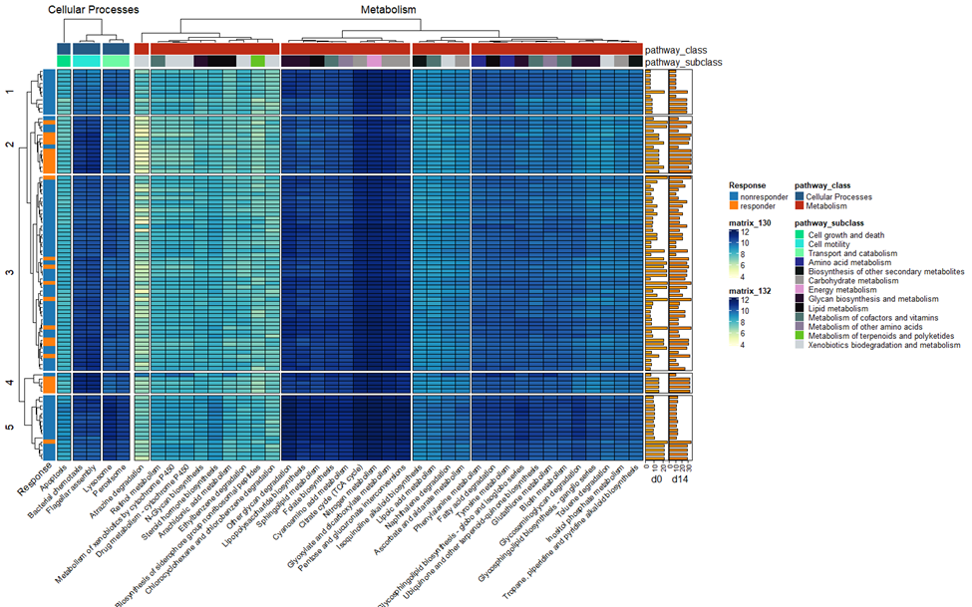
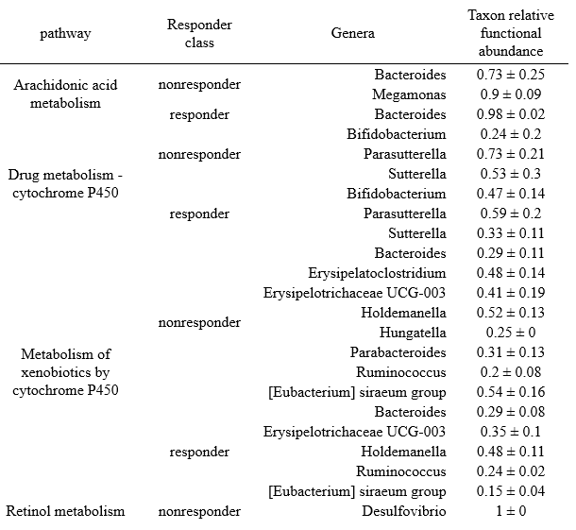
FeSST manuscript Figures
Supplementary Table 1. Taxonomic contributions to significantly differentially expressed inferred functions. Inferred functionally annotated microbiome KEGG pathways by taxon contribution with response to iron therapy defined as Ferritin <30 ng/ml at Day 14. Taxon relative functional abundance represents the proportion of that function’s abundance that is contributed by that particular taxon.
Figure 5. The heatmap represents the various microbial functions amongst individuals whom were iron deficient at baseline (day 0) (<30 ng/mL). The x axis depicts the predicted and significant KEGG orthologs and the y axis is the samples. The left y axis annotation further categorizes these individuals by responder and nonresponder according to their response to iron therapy based on Ferritin score <30 at day 14. The y annotation on the right is the Ferritin scores on day 0 and day 14 (ng/mL). The x axis is divided by pathway class (cellular processes and metabolism) and has an x axis annotation of pathway subclass. The color is the log1p of the predicted gene count for each sample. Samples (rows) and functions (columns) are ordered based on hierarchical clustering using Euclidean Distance.
Notes:
Taxon relative functional abundance in PICRUSt2 refers to the predicted proportion of functional genes present in a microbial community based on the relative abundance of taxonomic groups identified through 16S rRNA gene sequencing.
There were a total of 67 KEGG orthologs that were differentially abundant when comparing those that responded to iron therapy to those that did not.
Metabolism; Carbohydrate metabolism 8
Metabolism; Xenobiotics biodegradation and metabolism 8
Metabolism; Glycan biosynthesis and metabolism 6
Metabolism; Lipid metabolism 6
Metabolism; Metabolism of cofactors and vitamins 6
Metabolism; Biosynthesis of other secondary metabolites 4
Metabolism; Metabolism of terpenoids and polyketides 4
Metabolism; Amino acid metabolism 3
Metabolism; Metabolism of other amino acids 3
Cellular Processes; Cell growth and death 2
Cellular Processes; Cell motility 2
Cellular Processes; Transport and catabolism 2
Environmental Information Processing; Signal transduction 2
Genetic Information Processing; Replication and repair 1
Genetic Information Processing; Transcription 1
Metabolism; Energy metabolism 1

Slide 12
FeSST manuscript Figures
Notes:
This table shows the taxa that provided significant contributions to the aforemention differential functional microbiome pathways with the main takeaway being that again we are seeing
Taxon relative functional abundance in PICRUSt2 refers to the predicted proportion of functional genes present in a microbial community based on the relative abundance of taxonomic groups identified through 16S rRNA gene sequencing.

Slide 13
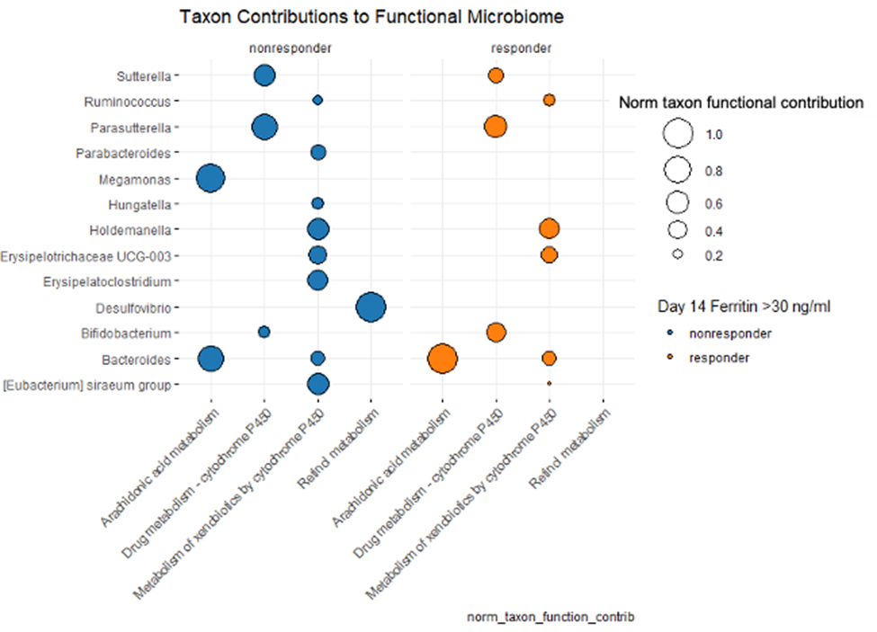
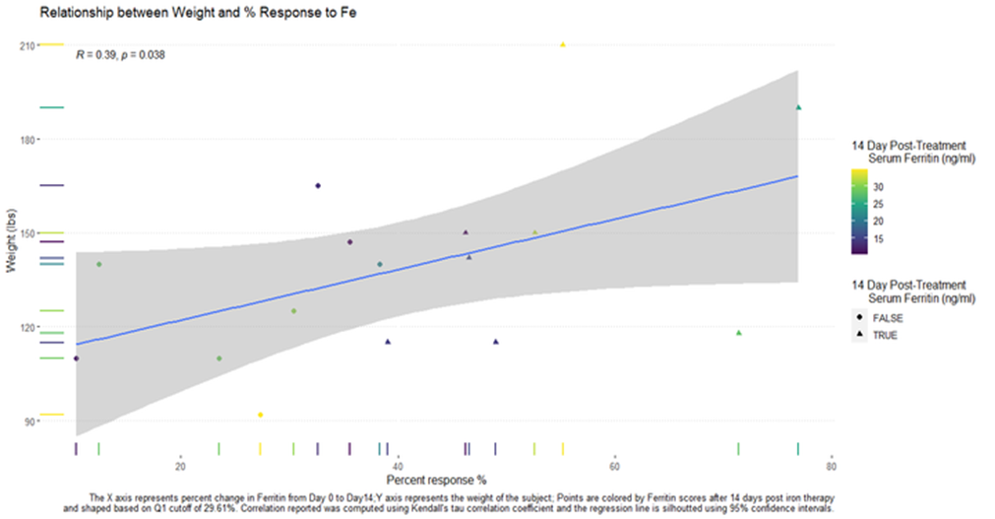
FeSST manuscript Figures
Supplementary Figure 1. Taxonomic contributions to significantly differentially expressed inferred functions. The x axis represents significantly inferred functionally annotated microbiome KEGG pathways faceted by response to iron therapy defined at Ferritin <30 ng/ml at Day 14. The y axis represents the different genera associated with significant contributions to the KEGG pathways. Nodes are colored by response to iron therapy and sized by the proportion of that function’s abundance that is contributed by that particular taxon.
Supplementary Figure 2. The X axis represents percent change in Ferritin from day 0 to day 14; Y axis represents the weight of the subject; Points are colored by Ferritin scores after 14 days post iron therapy and shaped based on Q1 cutoff of 29.61%. Correlation reported was computed using Kendall’s tau correlation and the regression line is silhouetted using 95% confidence intervals.
Notes:
The bubble lot shows a comparison of the normalized taxonomic function contributions for the pathways
Association between contribution of bugs and functions. Nodes are colored by response to iron therapy and sized by the proportion of that function’s abundance that is contributed by that particular taxon at treatment. Metabolism of xenobiotics by cytochrome P450 is an abundant function among the nonresponders.
Other figure shows relationship between weight and percent response to ferritin from day 0 to 14.

Slide 14
FeSST manuscript Figures
Permutation test for adonis under reduced model
Df SumOfSqs R2 F Pr(>F)
responder 1 1.7792 0.06762 6.5779 0.001 ***
day 1 0.0832 0.00316 0.3077 1.000
tmt_respond:day 1 0.1058 0.00402 0.3912 0.996
Residual 90 24.3439 0.92519
Total 93 26.3122 1.00000
---
Signif. codes: 0 '***' 0.001 '**' 0.01 '*' 0.05 '.' 0.1 ‘ ’ 1
Supplementary Table 2. Beta diversity adonis PERMANOVA reporting statistical significance with response to iron therapy as defined by <30ng/ml on Day 14 (n permutations = 999).
Notes:
Table shows that response to iron therapy was significant
This is the result from an adonis permutational analysis of variance showing that we observed a significant difference in beta diversity based on bray curtis dissimilarity associated with response to iron therapy.

Slide 15
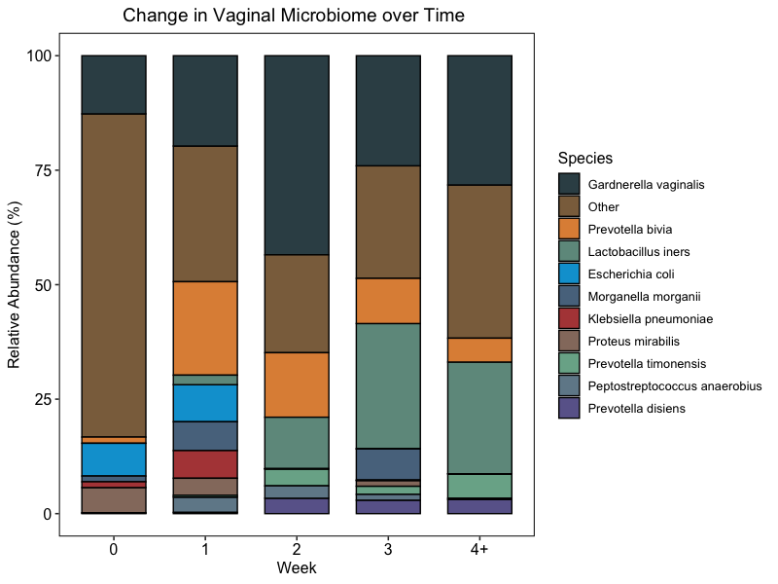
Fistula study
Figure 1. The stacked bar chart displays the WGS derived average change of the relative abundance (%) (y-axis) in the vaginal microbiome over time (x-axis) before (week 0) and after (weeks 1-4+) fistula repair. Taxa are distinguished by color for the 11 most prevalent species ordered by abundance (greatest to least).
Notes:
In regards to the fistula study, this stacked bar chart depicts the average change in relative abundance of bugs in the vaginal microbiome before and after fistula repair (in weeks). Graphed 11 most prevalent species. Can see E. coli disappeared after repair, peptostreptococcus anaerobis appeared, and prevotella bivia increased
,

Slide 16
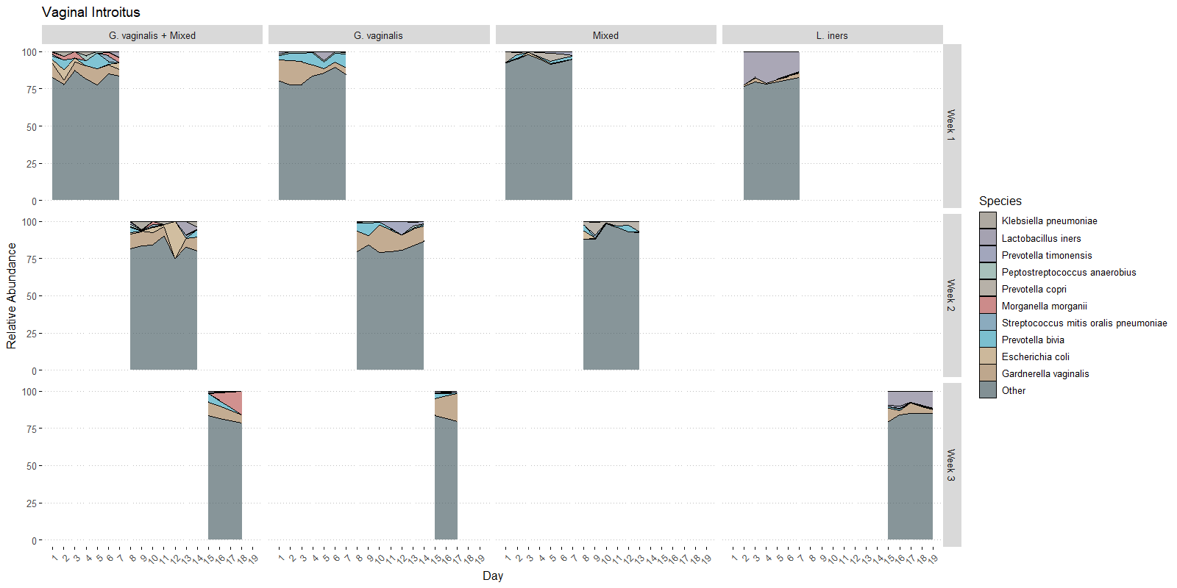
Fistula study
dmm Week 1 Week 2 Week 3
1 40 30 4
2 13 13 4
3 7 9 1
4 5 1 6
n = 40
n = 13
n = 7
n = 5
n = 30
n = 13
n = 9
n = 1
n = 4
n = 4
n = 1
n = 6
Figure X. Microbiome community composition stacked area charts representing mean relative abundance of keystone species (y axis) over time in days (x axis) across the different dmm groupings in the Vaginal Introitus.

Slide 17

Thanks!

Slide 18
Supplemental

Slide 19
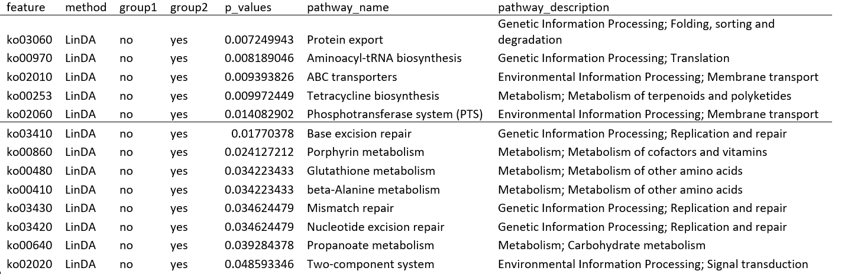

Slide 21
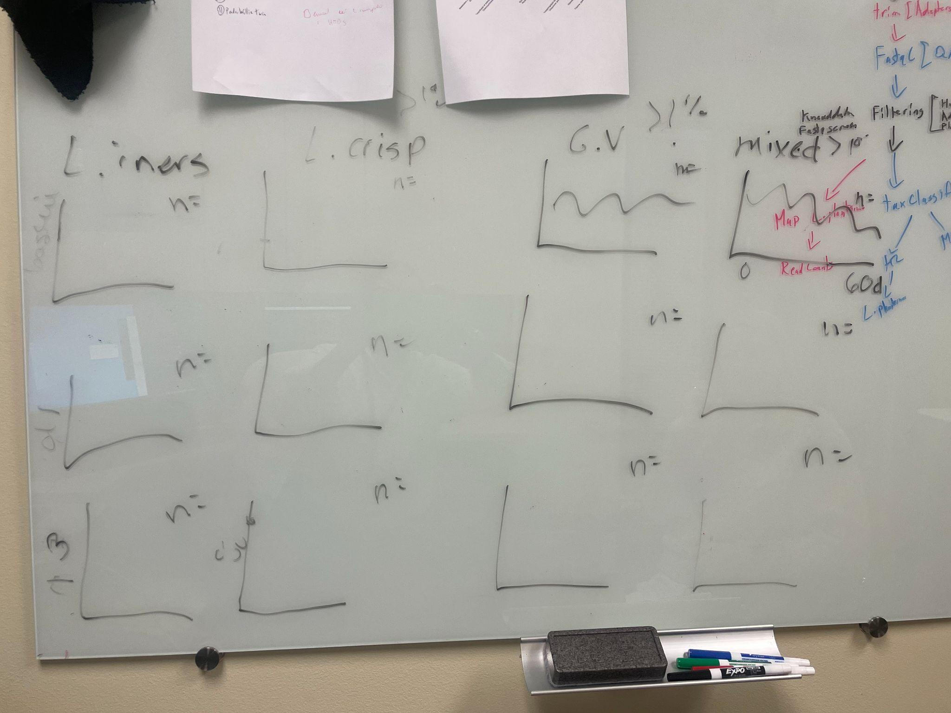

Slide 22
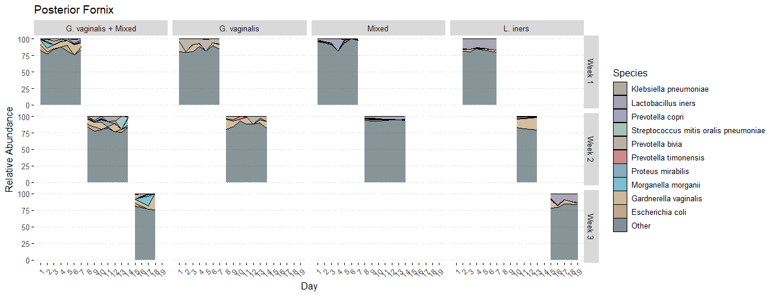
Week
dmm Week 1 Week 2 Week 3 Week 4
1 33 24 7 0
2 13 14 2 0
3 12 10 0 1
4 7 2 6 0

Slide 23
pathway_name pathway_map
Protein export The protein export is the active transport of proteins from the cytoplasm to the exterior of the cell, or to the periplasmic compartment in Gram-negative bacteria. The sec dependent pathway is the general protein export system that transports newly synthesized proteins into or across the cell membrane. The translocation channel is formed from a conserved trimeric membrane protein complex, called the Sec61/SecY complex. The twin-arginine translocation (Tat) pathway is another protein transport system that transports folded proteins in bacteria, archaea, and chloroplasts. Many Tat systems comprise three functionally different membrane proteins, TatA, TatB, and TatC, but TatA and TatE seem to have overlapping functions, with TatA having by far the more important role.
Aminoacyl-tRNA biosynthesis NA
ABC transporters The ATP-binding cassette (ABC) transporters form one of the largest known protein families, and are widespread in bacteria, archaea, and eukaryotes. They couple ATP hydrolysis to active transport of a wide variety of substrates such as ions, sugars, lipids, sterols, peptides, proteins, and drugs. The structure of a prokaryotic ABC transporter usually consists of three components; typically two integral membrane proteins each having six transmembrane segments, two peripheral proteins that bind and hydrolyze ATP, and a periplasmic (or lipoprotein) substrate-binding protein. Many of the genes for the three components form operons as in fact observed in many bacterial and archaeal genomes. On the other hand, in a typical eukaryotic ABC transporter, the membrane spanning protein and the ATP-binding protein are fused, forming a multi-domain protein with the membrane-spanning domain (MSD) and the nucleotide-binding domain (NBD).
Tetracycline biosynthesis Tetracyclines are aromatic polyketide antibiotics produced by Streptomyces species via type II polyketide synthases (PKSs). Tetracyclines contain a linear tetracyclic skeleton, which is formed from a malonamate starter unit and malonyl-CoA extender units through a common polyketide pathway [MD:M00778]. This diagram shows biosynthesis of naturally occurring tetracyclines (tetracycline, oxytetracycline and chlortetracycline) via a common intermediate anhydrotetracycline [MD:M00780 M00823].
Phosphotransferase system (PTS) The phosphoenolpyruvate (PEP)-dependent phosphotransferase system (PTS) is a major mechanism used by bacteria for uptake of carbohydrates, particularly hexoses, hexitols, and disaccharides, where the source of energy is from PEP. The PTS consists of two general components, enzyme I (EI) and histidine phosphocarrier protein (HPr), and of membrane-bound sugar specific permeases (enzymes II). Each enzyme II (EII) complex consists of one or two hydrophobic integral membrane domains (domains C and D) and two hydrophilic domains (domains A and B). EII complexes may exist as distinct proteins or as a single multidomain protein. The PTS catalyzes the uptake of carbohydrates and their conversion into their respective phosphoesters during transport. There are four successive phosphoryl transfers in the PTS. Initial autophosphorylation of EI, using PEP as a substrate, is followed by transfer of the phosphoryl group from EI to HPr. EIIA catalyzes the self-phosphoryl transfer from HPr after which the phosphoryl group is transferred to histidine or cysteine residues of EIIB. The sugar is transported through the membrane-bound EIIC and is phosphorylated by the appropriate sugar-specific EIIB.
Base excision repair Base excision repair (BER) is the predominant DNA damage repair pathway for the processing of small base lesions, derived from oxidation and alkylation damages. BER is normally defined as DNA repair initiated by lesion-specific DNA glycosylases and completed by either of the two sub-pathways: short-patch BER where only one nucleotide is replaced and long-patch BER where 2-13 nucleotides are replaced. Each sub-pathway of BER relies on the formation of protein complexes that assemble at the site of the DNA lesion and facilitate repair in a coordinated fashion. This process of complex formation appears to provide an increase in specificity and efficiency to the BER pathway, thereby facilitating the maintenance of genome integrity by preventing the accumulation of highly toxic repair intermediates.
Porphyrin metabolism Porphyrins are a group of chemical compounds with the backbone ring structure consisting of four linked pyrrole units. Metal complexes of porphyrins, as well as those of corrinoids with the one-carbon shorter ring structure, play important biological roles. They include iron-containing heme, magnesium-containing chlorophyll, nickel-containing coenzyme F430 and cobalt-containing cobamide (such as vitamin B12 coenzyme) as shown in this map.
Glutathione metabolism NA
beta-Alanine metabolism NA
Mismatch repair DNA mismatch repair (MMR) is a highly conserved biological pathway that plays a key role in maintaining genomic stability. MMR corrects DNA mismatches generated during DNA replication, thereby preventing mutations from becoming permanent in dividing cells. MMR also suppresses homologous recombination and was recently shown to play a role in DNA damage signaling. Defects in MMR are associated with genome-wide instability, predisposition to certain types of cancer including HNPCC, resistance to certain chemotherapeutic agents, and abnormalities in meiosis and sterility in mammalian systems.
Nucleotide excision repair Nucleotide excision repair (NER) is a mechanism to recognize and repair bulky DNA damage caused by compounds, environmental carcinogens, and exposure to UV-light. In humans hereditary defects in the NER pathway are linked to at least three diseases: xeroderma pigmentosum (XP), Cockayne syndrome (CS), and trichothiodystrophy (TTD). The repair of damaged DNA involves at least 30 polypeptides within two different sub-pathways of NER known as transcription-coupled repair (TCR-NER) and global genome repair (GGR-NER). TCR refers to the expedited repair of lesions located in the actively transcribed strand of genes by RNA polymerase II (RNAP II). In GGR-NER the first step of damage recognition involves XPC-hHR23B complex together with XPE complex (in prokaryotes, uvrAB complex). The following steps of GGR-NER and TCR-NER are similar.
Propanoate metabolism NA
Two-component system Two-component signal transduction systems enable bacteria to sense, respond, and adapt to changes in their environment or in their intracellular state. Each two-component system consists of a sensor protein-histidine kinase (HK) and a response regulator (RR). In the prototypical two-component pathway, the sensor HK phosphorylates its own conserved His residue in response to a signal(s) in the environment. Subsequently, the phosphoryl group of HK is transferred onto a specific Asp residue on the RR. The activated RR can then effect changes in cellular physiology, often by regulating gene expression. Two-component pathways thus often enable cells to sense and respond to stimuli by inducing changes in transcription.

